Slide 1

Introduction to NLP
Video 2: Common task in a NLP Project

Slide 2
Natural Language Processing
NLP Project
Text Classification
Text Generation

Slide 3
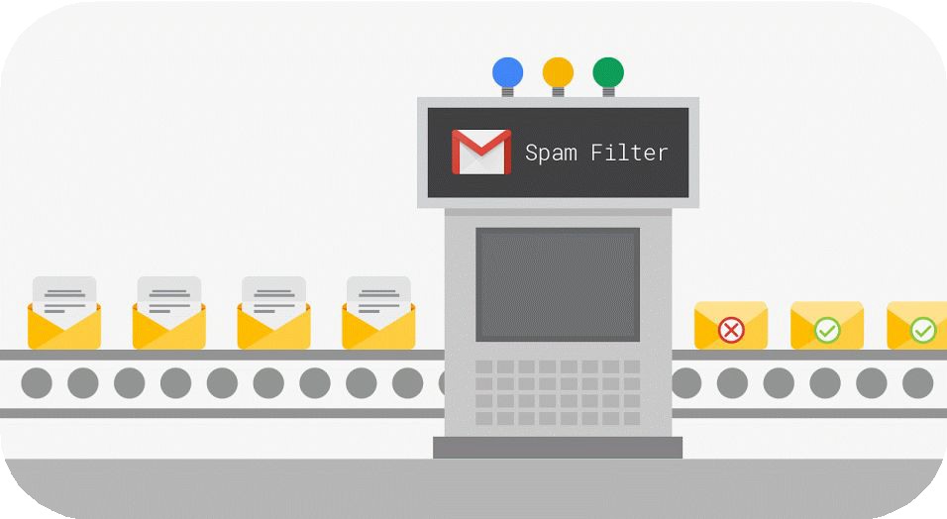
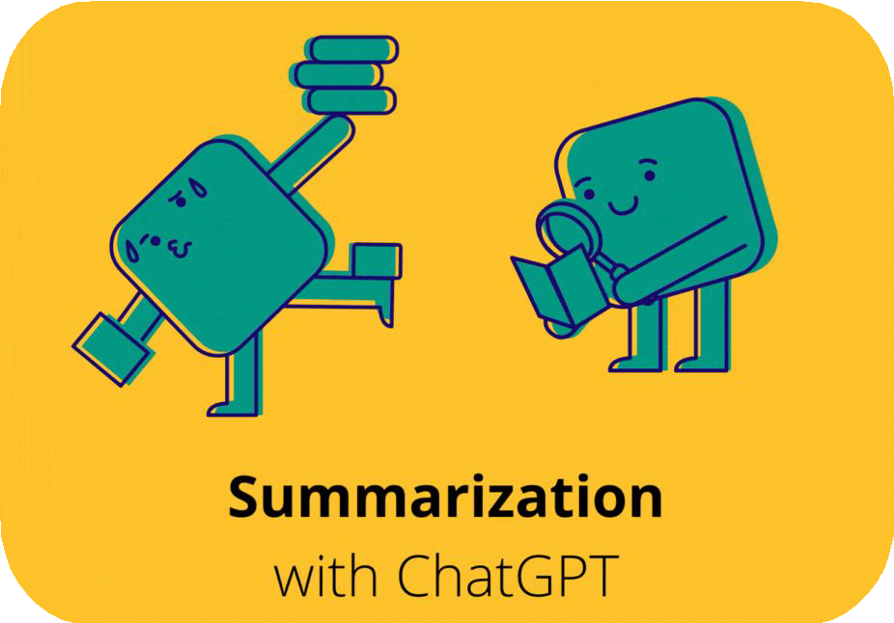
NLP Projects
1. Text Classification
2. Text Generation
Segregate texts based on the content
Generate text based on certain inputs

Slide 4


Techniques in NLP
Common Preprocessing Techniques
Advanced Techniques

Slide 5
Techniques in NLP
Common Preprocessing Techniques
Advanced Techniques

Slide 6

Common Preprocessing Techniques
Count of total occurance
Document | pets | animal | cats | dogs | fish
Cats and dogs are pets | 1 | 0 | 1 | 1 | 0
Wild animals are not pets | 1 | 1 | 0 | 0 | 0
Some people keep fish as pets | 1 | 0 | 0 | 0 | 1

Slide 7
Common Preprocessing Techniques
Count of total occurance
Break text into individual words
Cats
and
dogs
are
pets

Slide 8
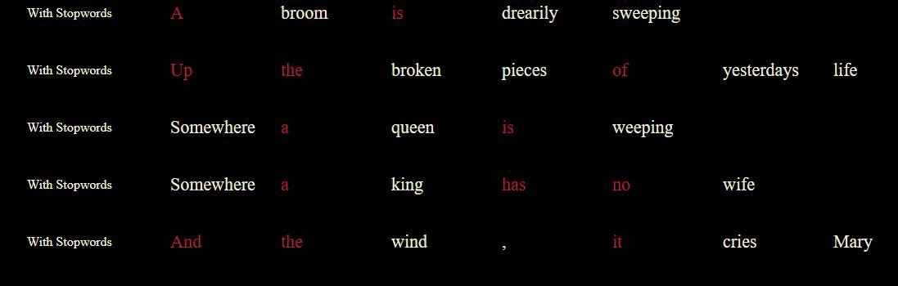
Common Preprocessing Techniques
Count of total occurance
Break text into individual words
Removal of stop words like “a”, “the”, “is” etc.

Slide 9
Common Preprocessing Techniques
Count of total occurance
Break text into individual words
Removal of stop words like “a”, “the”, “is” etc.
Convert all text to lowercase
RAW | Lowercase
Cat CAT cAt | cat

Slide 10
Common Preprocessing Techniques
Count of total occurance
Break text into individual words
Removal of stop words like “a”, “the”, “is” etc. Convert all text to lowercase
Reduce words to their root form called lemma
Original word | Lemmatized word
trouble troubling Troubled troubles | trouble

Slide 11
Techniques in NLP
Common Preprocessing Techniques
Advanced Techniques

Slide 12
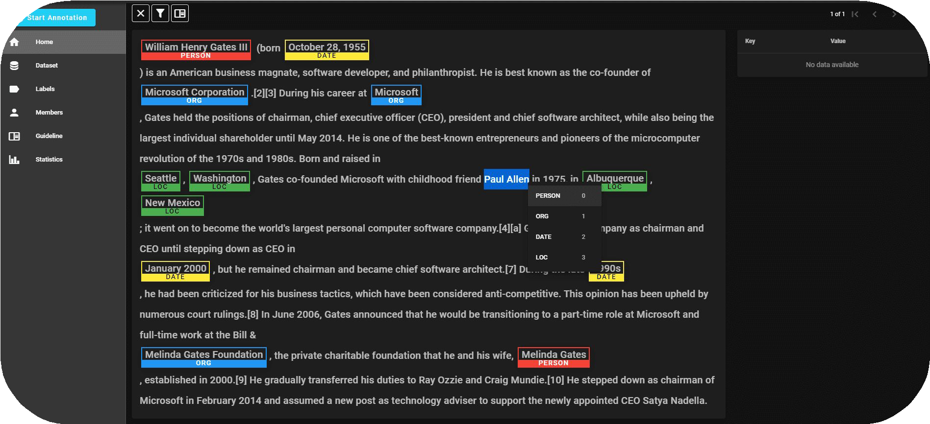
1. Name Entity Recognition

Slide 13
2. Word Embeddings
Cat
Cat
Kitten
0.6 | 0.9 | 0.1 | 0.4 | -0.7 | -0.3 | -0.2
0.5 | 0.8 | -0.1 | 0.2 | -0.6 | -0.5 | -0.1
0.7 | -0.1 | 0.4 | 0.3 | -0.4 | -0.1 | -0.3
House
Dog
Puppy
-0.8 | -0.4 | -0.5 | 0.1 | -0.9 | 0.3 | 0.8
Dog
Kitten Puppy
House
-0.8 | -0.4 | -0.5 | 0.1 | -0.9 | 0.3 | 0.8
Word
Word Embedding
Visualization of word embedding in 2D

Slide 14
3. Fine Tuning Pre-trained models
Question Answering
Fine tuning
Large amount of text datal
Pre-Trained Model
Fine tuning
Sentiment Analysis
Fine tuning
Text Summarization

Slide 15
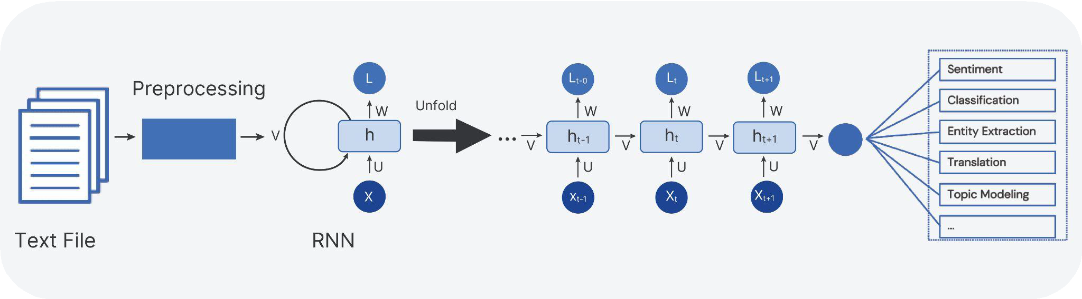
4. Building Deep learning models

Slide 16
Techniques in NLP
Common Preprocessing Techniques
Advanced Techniques

